Slide 1
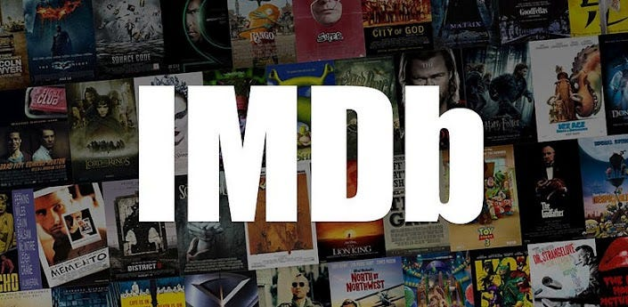
Movie Analysis

Slide 2
PROJECT DESCRIPTION
IMDb is currently the most popular ratings and entertainment media database in the world. IMDb stands for "Internet Movie Database." IMDb is a reputed platform that hosts information related to movies, television shows, video games, reality shows, and OTT content. In this project the dataset provided is related to IMDB Movies.
A potential problem to investigate could be: "What factors influence the success of a movie on IMDB?" Here, success can be defined by high IMDB ratings. The impact of this problem is significant for movie producers, directors, and investors who want to understand what makes a movie successful to make informed decisions in their future projects.

Slide 3
APPROACH
Once the dataset is received below steps are performed:
Data Cleaning: This step involves preprocessing the data to make it suitable for analysis. It includes handling missing values, removing columns which are not required for analysis, handling duplicate data, removing unwanted characters such as Ã‰,Ã , Ã,Ã© .
Data Analysis: Here data is explored to understand the relationships between different variables.

Slide 4


TECH-STACK USED
Microsoft Office 2019 is used
MS Excel is used to enter data in table format, perform computations using functions, statistical methods and plot graphs etc. MS Excel used to filter and clean the data to get insights.
Microsoft PowerPoint 2019
It is used for documenting the insights and give presentation to movie producers, directors, and investors who want to understand what makes a movie successful to make informed decisions in their future projects.

Slide 5
INSIGHTS AND RESULTS
TASK A: MOVIE GENRE ANALYSIS
As per the above chart the popular genre is drama.
Next comes comedy, thriller, action, romance, adventure and crime.

Slide 6
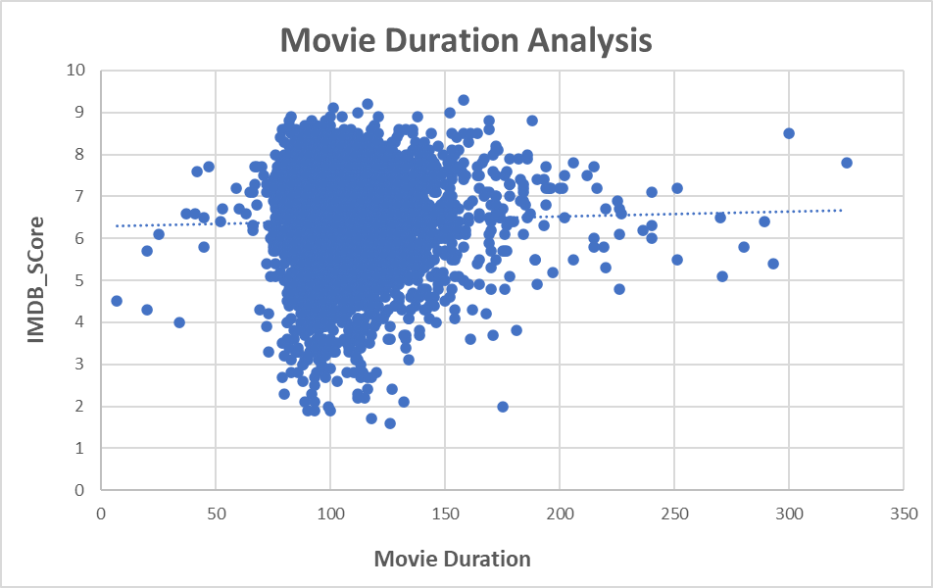
TASK B: MOVIE DURATION ANALYSIS
From the above chart we observe that there is weak correlation between the movie duration and IMDB score.
Here the movies length does not effect the movie score.
From the trendline we can predict that with increase in movie duration we can increase the movie score.

Slide 7
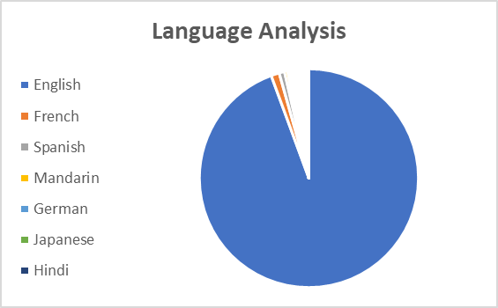
TASK C: LANGUAGE ANALYSIS
Language | Count of Movies
English | 4163
French | 54
Spanish | 35
Mandarin | 20
German | 15
Japanese | 15
Hindi | 14
As per the above analysis most of movies are in English language.
Above table shows the top 7 languages used in the movies.

Slide 8
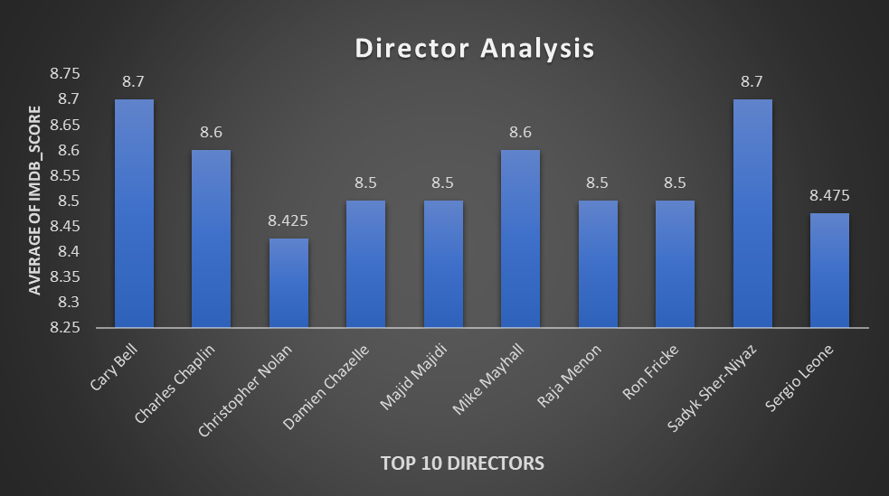
TASK D: DIRECTOR ANALYSIS
The bar chart shows the top 10 directors as per the average of IMDB score.
Cary Bell and Sadyk Sher-Niyaz are the top most directors who has a score 8.7

Slide 9
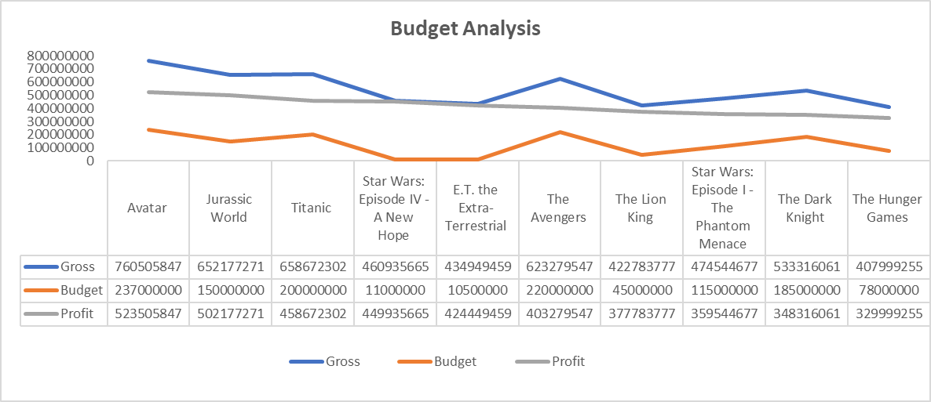
TASK E: BUDGET ANALYSIS
Avatar movie is the high profitable movie among the top 10.
Above graph shows top 10 profitable movies with the profit ,budget and gross details.
As per the above analysis the profit of the movie does not completely depend on the gross and budget of the movie.
The correlation between the gross and budget is 86%.

Slide 10
DRIVE LINK: https://drive.google.com/drive/folders/1ZxWBD63IFBhKcAuGwZvNwKgyLfDMCV8o?usp=drive_link
EXCEL FILE LINK:
For further details of analysis PFA excel link:
VIDEO PRESENTATION LINK:
https://www.loom.com/share/097284952d5344a3a6c48adbfea1dab7?sid=a75b92a1-3316-44b0-be3a-8249210de866

Slide 11
THANK YOU

